Slide 1
DENSENET-121
A BRIEF STUDY

Slide 2
What is Dense Neural Network ?
The name itself suggests that it is a convolutional neural network and it’s layers are connected densly by the nuerons in a network layer.
Each neuron in a layer gets input from all the previous layers in order to prevent over fitting.
Another important advantage of such an architecture is the ability to reuse features, while maintaining a low number of parameters in total.

Slide 3
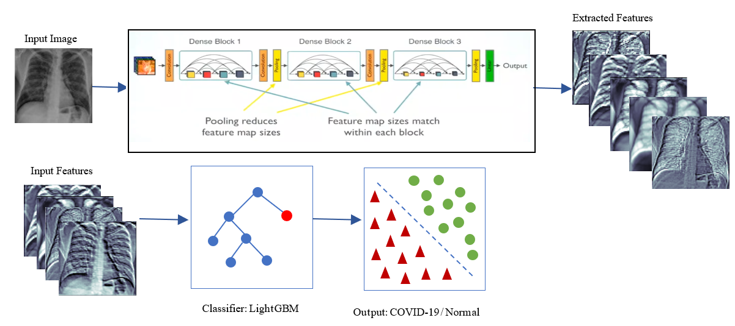

Slide 4
Process:
Image Dataset is cleansed.
In the Architecture:
Deep Features are extracted from each input images by
a)Convolution.
b)Relu Activation.
c)Global Average Pooling.
These features are used to predict the presence of opacities.
later phases features are validated for better acuracy and validation.

Slide 5
Keywords:
Convoulution:Is the process of extracting features from an image using a mask.
Layer: a Layer is nothing but a feature map produced after convolution of input image.
Relu: Short form for Rectified Linear unit which considers only dominant features of the layer and ignores other.
Global Average Pooling: This is responsible for controlling the parameters and segmenting the features into a layer.

Slide 6
Up until now we have learnt about Convolution and Relu work orally. Now lets see how it happens pictorically.

Slide 8
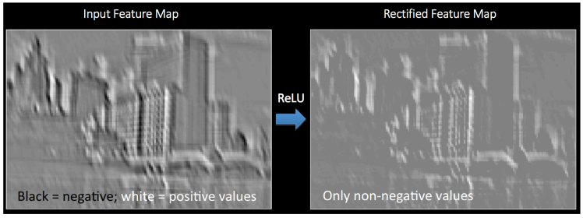

Slide 9
References:
https://medium.com/@RaghavPrabhu/understanding-of-convolutional-neural-network-cnn-deep-learning-99760835f148.
https://ujjwalkarn.me/2016/08/11/intuitive-explanation-convnets/

